Slide 1
Greek Subordinate Clauses taking the Indicative Mood
Prof. Vanessa Gorman
University of Nebraska-Lincoln
vgorman1@unl.edu

Slide 2
Main Types of Subordinate Clauses that take the Indicative Mood
Temporal Clauses
Causal Clauses
Comparison Clauses
Substantive Clauses
Conditional Sentences
*Relative
*later

Slide 3
Temporal Clauses [ADV]

Slide 4
Ways of expressing Time
Prepositions like μετὰ δέ ταῦτα
Adverbs like νῦν, τότε, ἔπειτα, etc.
Acc neut adjectives like ὕστερον
Oblique cases
Dative of time when
Genitive of time within which
Acc of extent of time
Participles [later]
Subordinate temporal clauses

Slide 5
Common Conjunctions used to introduce Temporal Clauses [labeled AuxC]
ὅτε when
ἕως, μέχρι until
ἐπεί (ἐπειδή), ὡς after, when
πρίν before, until

Slide 6
Temporal Clauses [ADV]
A simple temporal clause referring to a single action in the past takes the indicative mood.
Imperfect = incomplete or simultaneous action
Aorist = completed action
Negated by οὐ/οὐκ [AuxZ]

Slide 7
Reading trees of subordinate clauses
The subordinating conjunction is always labelled AuxC
The verb of the clause is hung on the conjunction and is labelled according to the function of the clause in the sentence.
The remaining elements are labelled as normal, in relationship to the verb of the clause
Note: It is not unusual for verbs to be elided
The verb “to be”
If the verb is the same as that of the main clause.

Slide 8
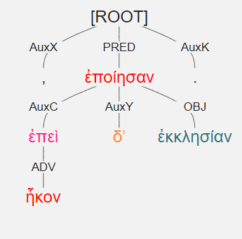
ἐπεὶ δʼ ἧκον, ἐκκλησίαν ἐποίησαν. [2.2.19]
When they came, they called an assembly.

Slide 9
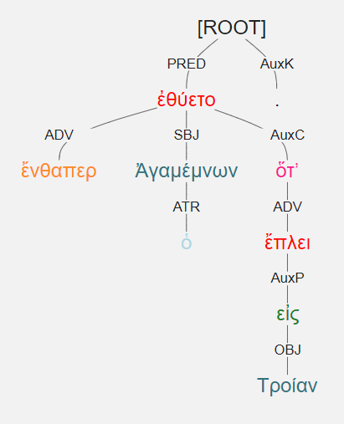
ἔνθαπερ ὁ Ἀγαμέμνων ὅτʼ εἰς Τροίαν ἔπλει ἐθύετο. [3.4.3]
When he sailed to Troy, Agamemnon made a sacrifice there.
When he sailed to Troy, Agamemnon made a sacrifice there.

Slide 10
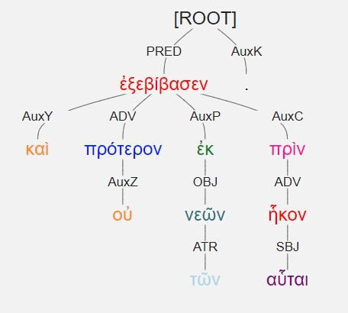
καὶ οὐ πρότερον ἐξεβίβασεν ἐκ τῶν νεῶν πρὶν αὗται ἧκον. [2.1.24]
He did not disembark from the ships until they had arrived.

Slide 11
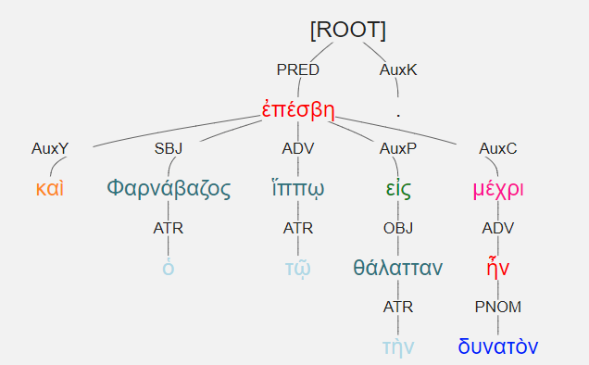
καὶ ὁ Φαρνάβαζος ἐπέσβη τῷ ἵππῳ εἰς τὴν θάλατταν μέχρι δυνατὸν ἦν. [1.1.6]
And Pharnabazos went out on his horse into the sea as far as he was able. [spatial sense]
Literally: as far as it was possible [impersonal construction]

Slide 12
Causal Clauses [ADV]
Those indicating a fact take the indicative introduced by ὅτι or ἐπεί [“because”]

Slide 13
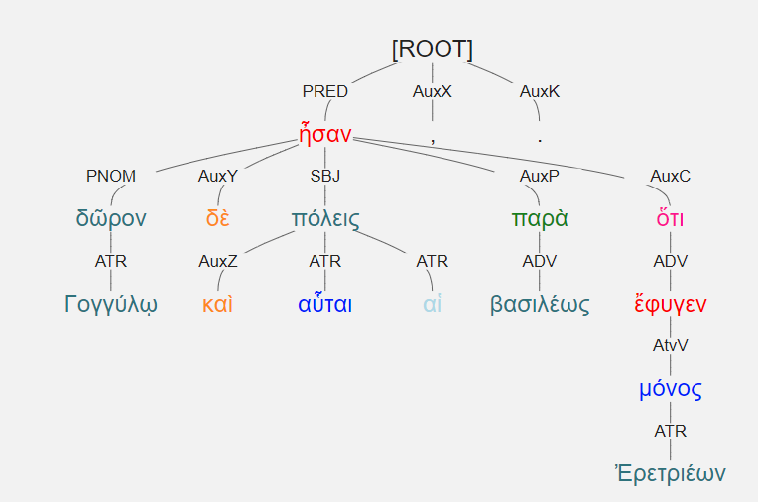
δῶρον δὲ καὶ αὗται αἱ πόλεις ἦσαν παρὰ βασιλέως Γογγύλῳ, ὅτι μόνος Ἐρετριέων ἔφυγεν. [3.1.6]
Those cities were a gift from the King to Gongylos because he alone of the Eretrians fled.

Slide 14
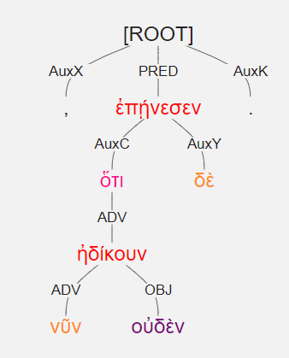
ὅτι δὲ νῦν οὐδὲν ἠδίκουν, ἐπῄνεσεν. [3.2.6]
They approved, because they [others] were doing nothing wrong now.

Slide 15
Comparison Clauses [ADV]
Introduced by ὡς [“as”]

Slide 16
Ways of Expressing Comparison
Genitive of comparison
Verbs that imply a comparison take a genitive object
Superlatives with the partitive genitive (“best of all”)
When comparing to a genitive or dative:
ἤ = “than”
μᾶλλον (ἤ) = “more than” or “rather than”
With Dative of Degree of Difference
ὡς (ὥσπερ) + indicative = “as” or “just as”
Sometimes preceded by οὕτως [“thus”] in the main clause

Slide 17
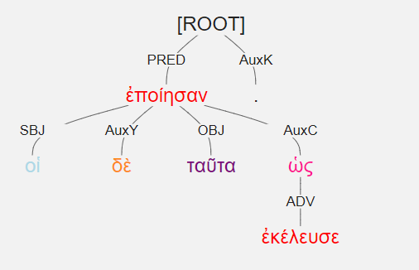
οἱ δὲ ταῦτα ἐποίησαν ὡς ἐκέλευσε. [2.1.27]
They did these things just as he ordered.

Slide 18
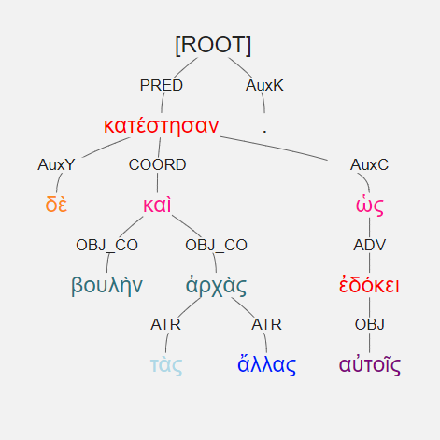
βουλὴν δὲ καὶ τὰς ἄλλας ἀρχὰς κατέστησαν ὡς ἐδόκει αὐτοῖς. [2.3.11]
They appointed a Council and the other magistrates just as seemed best to them.

Slide 19
Substantive Clauses
Introduced by ὡς or ὅτι [“that”]

Slide 20
Substantive Clauses [SBJ, OBJ, etc.]
Plays the part of a substantive in the main clause
“That”
After verbs of emotion: “rejoicing, grieving, wondering.”
After impersonal verbs
After verbs of “saying, knowing, perceiving, showing.”

Slide 21
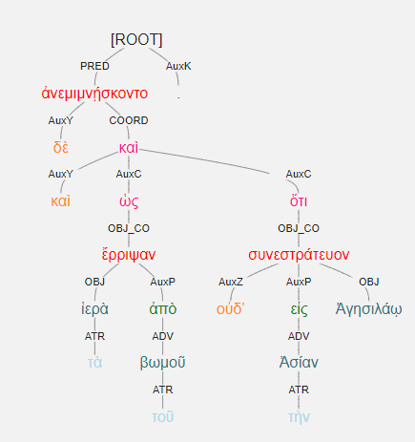
ἀνεμιμνῄσκοντο δὲ καὶ ὡς τὰ ἱερὰ ἔρριψαν ἀπὸ τοῦ βωμοῦ καὶ ὅτι οὐδʼ εἰς τὴν Ἀσίαν Ἀγησιλάῳ συνεστράτευον. [3.5.5]
They were remembering both that they had ripped the sacrifices from the altar and that they would not fight alongside Agesilaus in Asia.

Slide 22
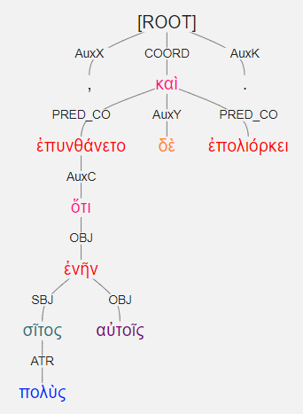
ἐπυνθάνετο δὲ ὅτι πολὺς σῖτος ἐνῆν αὐτοῖς, καὶ ἐπολιόρκει. [3.2.11]
He understood that they had a great deal of grain, and he besieged them.
[literally: much grain was to them]

Slide 23
Conditional Sentences [ADV]

Slide 24
Conditional Sentences [ADV]
If … then statements
The “if” clause is dependent. It is the protasis.
The “then” clause is independent. It is the apodosis.
“Then” is often unexpressed.
Uses different moods depending on the likelihood of the condition’s fulfillment
If Persia invades again, then we will not be able to defend ourselves.
If it were to rain, I would have to delay my departure.
If he had departed on time, he would be here by now.

Slide 25
Simple Conditional Sentences
State a supposition with no implication of its reality
If it rains, I get wet. [present]
If it rained, I got wet. [past]
Expressed by εἰ + indicative [protasis] > indicative [apodosis]
Past tenses make it past; present or perfect make it present

Slide 26
Unreal or Contrary-to-Fact Conditional Sentence
States a supposition that cannot be realized because it is in contradiction to a known fact.
If it were raining, I would be getting wet. [present] [were > would]
But it isn’t, so I am not.
If it had rained, I would have gotten wet. [past] [had > would have]
But it didn’t, so I did not.
Expressed by εἰ + indicative [protasis] > indicative + ἄν [apodosis]
Present Unreal = εἰ + imperfect > imperfect + ἄν
Past Unreal = εἰ + aorist or imperfect > aorist or imperfect + ἄν

Slide 27
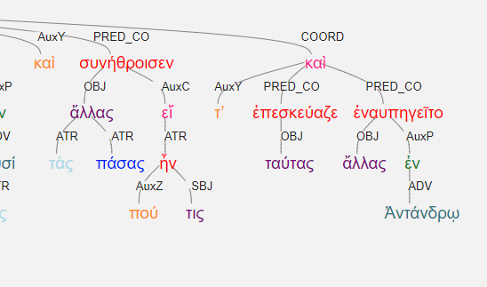
Λύσανδρος τὰς ἄλλας πάσας συνήθροισεν, εἴ πού τις ἦν, καὶ ταύτας τʼ ἐπεσκεύαζε καὶ ἄλλας ἐναυπηγεῖτο. [2.1.10]
Lysander collected all the other [ships], if there were any, and he was refitting them, and building others.

Slide 28
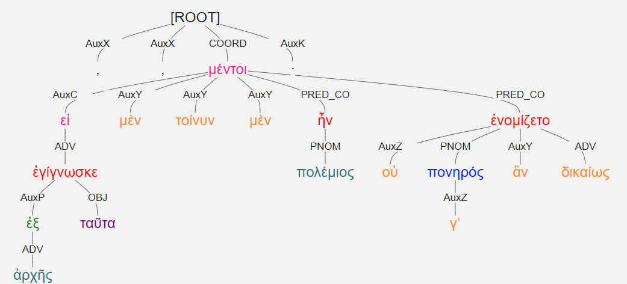
εἰ μὲν τοίνυν ἐξ ἀρχῆς ταῦτα ἐγίγνωσκε, πολέμιος μὲν ἦν, οὐ μέντοι πονηρός γʼ ἂν δικαίως ἐνομίζετο· [2.3.27]
If he was thinking these things all along, he was an enemy, however he would not justly be considered wicked.

Slide 29
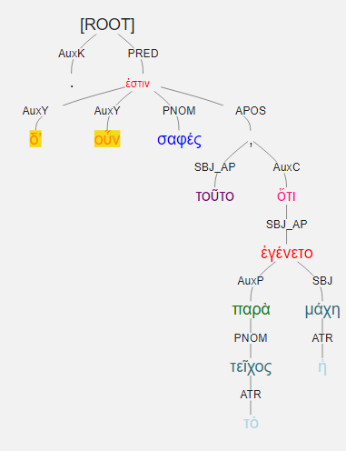
τοῦτο δʼ οὖν σαφές, ὅτι παρὰ τὸ τεῖχος ἡ μάχη ἐγένετο. [3.5.19]
Thus it was clear that the battle was near the wall.
Apositive

Slide 30
LEMMA | MEANING | POSTAG | Relation Label | CLAUSE or other use | COUNT
ἐάν [εἰ+ἄν] | if | CONJ | AuxC | conditional | 98
εἰ | if | CONJ | AuxC | conditional | 313
ἐπεί/ἔπειδή | when, after | CONJ | AuxC | temporal | 428
ἕως | until | CONJ | AuxC | temporal | 36
ἵνα | in order that | CONJ | AuxC | purpose | 27
μέχρι | until | CONJ | AuxC | temporal | 37
μέχρι | until | ADP | AuxP | prepositional phrase | 37
ὅπως | in order that, just as | CONJ | AuxC | purpose; manner | 90
ὅτε | when | CONJ | AuxC | temporal | 43
ὅτι | that | CONJ | AuxC | causal; vbs of saying, thinking, perceiving, fearing | 370
πρίν | until | CONJ | AuxC | temporal | 35
ὡς/ὥσπερ | when, after | CONJ | AuxC | purpose, comparison, indirect, result, temporal + adv and prep | 548
ὡς | as if | ADV | AuxX | emphasizing participle
ὥς | to | ADP | AuxP | place to which
ὥστε | so that | CONJ | AuxC | result | 123
ἄν | [potential] | ADV | AuxY | Sentence adverb | 311
μή | not | ADV | AuxZ | emphasizing participle | 272
μή | least | CONJ | AuxC | negative fearing clause | 272
μηδείς | no one | PRON |  | in clauses where μή would be used for negation | 189

